Slide 1

Gideons SY23 Budget

Slide 2
Agenda
Goals for the 2022-23 Budget
Drivers for Decisions In Our Budget
SY23 Budget Highlights
Threats to Our Budget

Slide 3
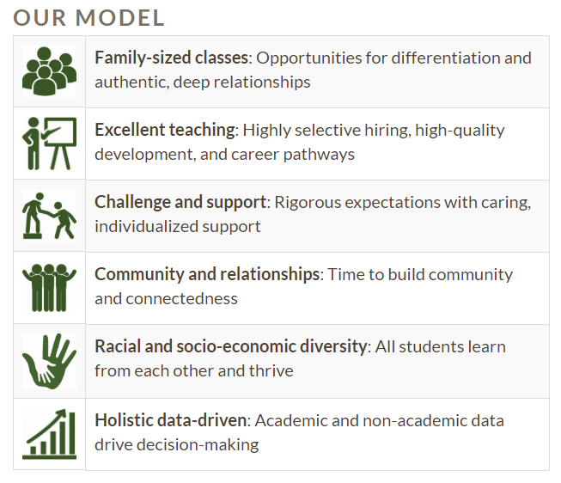
Goals for the 2021-22 Budget
A BUDGET THAT SUPPORTS OUR MODEL
Family-sized classes require more staff. We must be prudent financially to afford a larger team.
Commitment to our career pathways and paying a competitive wage to our team
Challenging ourselves to ask tough questions about equity, what does “market value” really mean for salaries
Ensuring there is space in our budget for outreach and events that support our community and reinforce our commitment to diversity.
Using data on current and past performance to project the future needs of our network

Slide 4
Goals for the 2022-23 Budget
A BUDGET THAT IS RESILIENT TO THE UNEXPECTED
The pandemic and economic hardships of the pandemic continue to reinforce the value of planning for the unexpected. This will be the third year ahead of us with significant uncertainty.
Our budget must balance against the needs of our schools and network versus the need to build in a surplus so we can weather any material changes to our financial plan.
Conservative approach to projecting revenues combined with a rigorous commitment to “living within our means.”
Capitalize on federal assistance to recover from COVID, but don’t build processes or programs that rely on federal funding in the long term.
Continue to increase our operating reserves to weather a potential multi-year downturn in revenue.
Take a conservative approach to projecting enrollment.

Slide 5
Drivers for Decisions in Our Budget
REVENUES
Our revenues are almost entirely dependent on tax revenue from Atlanta and the state.
  Revenues are heavily dependent on how many geniuses attend our schools and the training and experience of our staff.
We are relying less on fundraising for general operations than our historical average.
We will see significant reimbursements for spending related to COVID recovery and instructional improvements from CARES Acts 1-3. The last of these funds must be spent by September 2024.

Slide 6
Highlights for SY23 Budget
EXPENSES, SALARIES, AND SUPPORT IN FY23
We are continuing our commitment to increased spending on instructional materials, classroom support, SEL support, and coaching for staff and students due to the pandemic.
We project that funding from the Georgia DOE and APS will increase next year, giving us the ability to pass along salary increases to all staff.
While enrollment projections are uncertain in the long-term, we expect to maintain a similar size student population and staff size to the current school year.

Slide 7
Threats To Our Budget
Conditions That Could Make Revisions Necessary
Missing our enrollment targets by more than 5%
Staffing or enrollment disruptions due to viral outbreaks
Changes in legislation broadly affecting education
Property tax rate disputes on a widespread basis
Unplanned significant building repairs

Slide 8
Threats To Our Budget
Risk Analysis

